Slide 1
Swapnil sir data
https://drive.google.com/u/1/uc?id=15bZJOE-_VNqX5PuyM5NDiZUD-B10tOJq&export=download
https://drive.google.com/file/d/15bZJOE-_VNqX5PuyM5NDiZUD-B10tOJq/view

Slide 2
https://snipper.io/s/-McXW1gQlvgfbWrPqAKB

Slide 3
To Do List
Here we will follow some principles while coding, we will be segregating things into separate files, so that they are easier to track and easier to maintain, even though it is a single application, we will try to segregate things. We will call the messages in one files and trying to use them across in all other components, also we will see how it is useful?
Since ToDo List is completely new project we will create another app
or use app2. Rename it as TODO-LIST, now open this project in VS Code through cmd prompt.

Slide 4
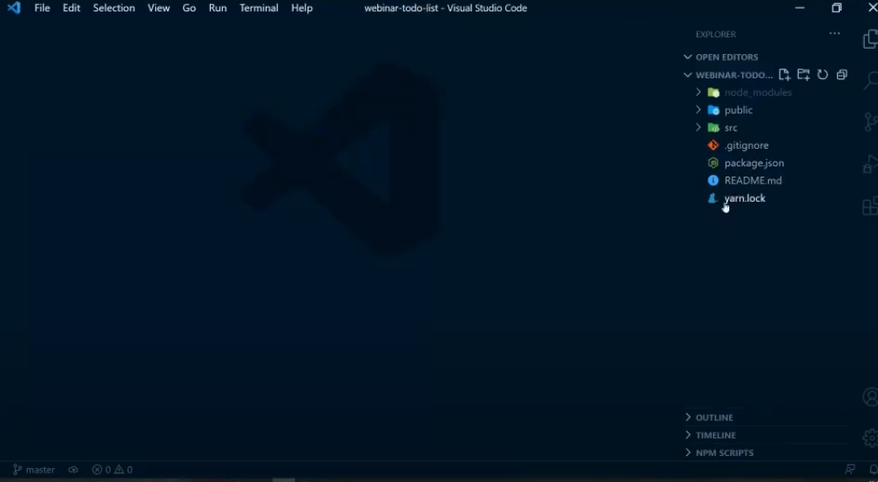
Right Now I have only this things available.

Slide 5
Now we will clear couple of things,
clear app.js in src we don’t required all this stuff, Just right rsf after clearing in app.js.
Delete app.css file,
Remove logo.svg
From public we don’t required logo192 and logo512.png, so will remove it.

Slide 6
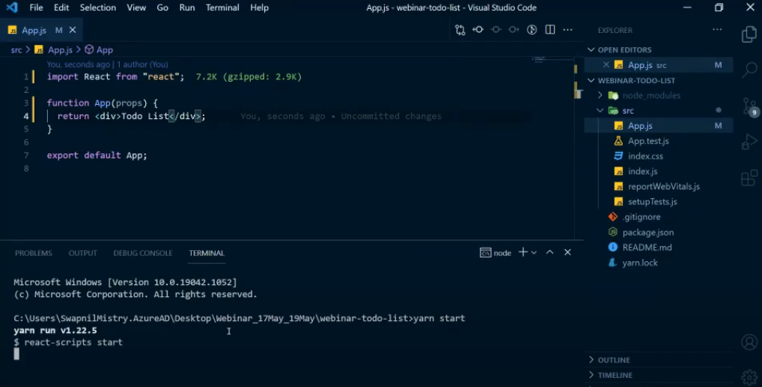
Add above text in app.js to check

Slide 7
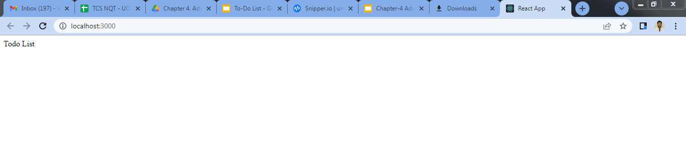

Slide 8
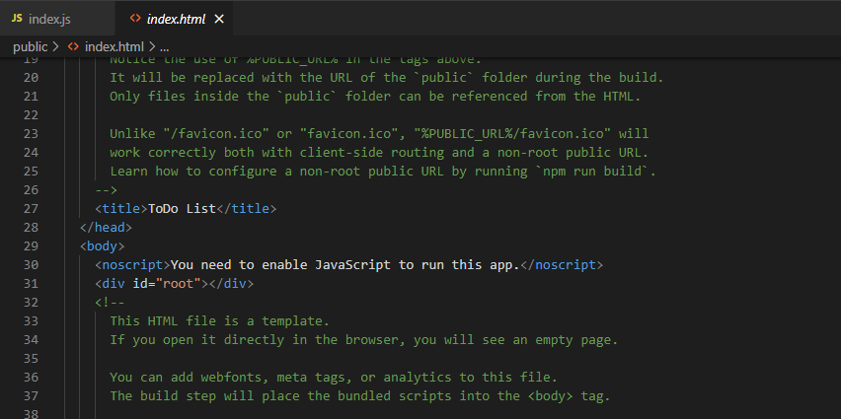
Change name from react app to ToDo List

Slide 9
Let’s understand what are the features we required in our ToDo List app,

Slide 10
https://snipper.io/s/-McXW1gQlvgfbWrPqAKB
Change the title in index.html <title>ToDo List</title>
Here we will create a simple ToDo list where we will have a search bar and a button, so whenever someone clicks on add todo so we will try to populate the list ToDo which we have created, we will have search bar and it is associated with button.
Searchbar -> Button -> Populate ToDos
Searchbar -> ToDos -> Populate ToDos
Let’s say if we populated ToDos what actions should be available to with respect to each ToDos, if I have multiple ToDos available over here, so what should be features available with me as of now -
a) Delete the Todo
b) Mark, Unmark as done
c) Delete all Todos. Above is a very basic Todo can offers to us, so we will try to mimic all this functionality.
Note:- we don’t have any backend as of now, so whenever you try to refresh the page your all the Todos will get lost, as of now we are trying to focus on react part i.e. frontend part. For backend part we have to combine with node.js where we can store data, where we will call to the backend, so you can create database at the backend where you will be string all your ToDos and you will be using your frontend for retrieval that ToDos..
We try to understand what data structure we required over here, since todos can be stored in the form of list, so will be using list over here in simple array, in that array each todo must have something, nothing but checked i.e. boolean value, so this will signify whether my Todos are marked done or it’s not marked. If it is true(isChecked: boolean) then we will show a checkbox as marked. A todo list and if it’s not then we will show false.

Slide 11
Then we will have message and that message will be having string, this is simple data structure which we are going to use over here array of objects, where we will have only two things w.r.to each Todo, where we will have todo marked and todo having message, If someone clicks on delete buttons then we need to delete it from the list, so we are not maintaining that infor as of now, we can add another thing like deleted, which can be also a boolean, (deleted: boolean) we can toggle it, if it is deleted then we can maintain it, but don’t delete it.
If someone say restore previous todos then we can iterate it through the list and marked this as true. Now here in this project we will delete it completely from our list completely,

Slide 12
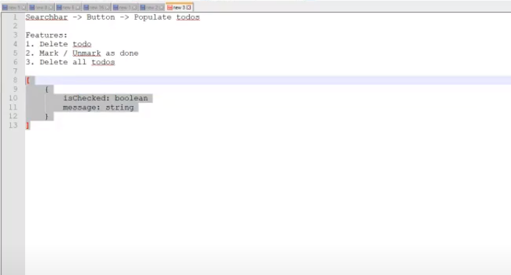
Here we will be following this structure,

Slide 13
In our app (app.js) we have nothing available with us we have only ToDo available, instead of app.js we will rename it to Todo.js and inside index.js we will import Todo.
Now we will create one directory called “ components” so whatever component associated with ToDo will be kept inside this and along with this we will create one more directory called “styles” so all the styles which are associated with Todos will be kept inside newly created style directory.
Now We will create one file inside src as Constants.js, which will try to store all the messages or alert or popup which we will be showing to user, if something wrong happens,
If I have project having multiple pages and same component is been used across all the pages, so we won’t end up by making it duplicate at multiple places, ex:- if i take a name of button name, i have declared same button at page a and same button at page b, so there’s no need to duplicate it, we can use the same thing from the single file itself, so it’s easier to maintain and changing a single page will replace it all other places where it is used.

Slide 14
Now we will move todo.js inside components,
New thing we will learn over here is that instead of creating .css file we will create file with different extensions which is called as .module.css.
We have Todo.module.css the reason behind doing this is that all the css with respect to only todo components should be listed inside this todo, so all the style which you specify inside this component will be applied only to the todo component and it won’t applied to the global files which are already present or the libraries which are already present. There is different way in which we need to import this file and you will also see the difference the way class names written while using this module.css and by using .css.
Now we will create another file called Global.css, Global.css is responsible for manipulating the css of other items which are present in the DOM / assigning style in other items in the dom, all the styles which are present in specific files will be override from global css,
,

Slide 15
If we have reactstrap library available, and each and every library will have some tags and styles associated with it, if I want override this style, so all those styles will come inside global.css, and the name itself suggesting that all the overriding of styles will come from different components or different library, which we are using. That all strictly written inside global.css,

Slide 16
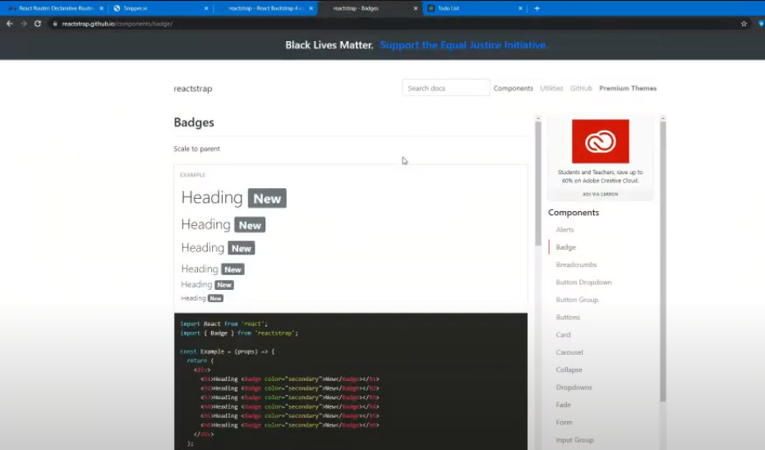
https://reactstrap.github.io/components/badge/

Slide 17
Do the changes in Todo.js
import React from 'react';
function ToDo(props) {
return (
<div>
Todo List
</div>
);
}
export default ToDo;

Slide 18
Now we need to install couple of things over here,

Slide 19
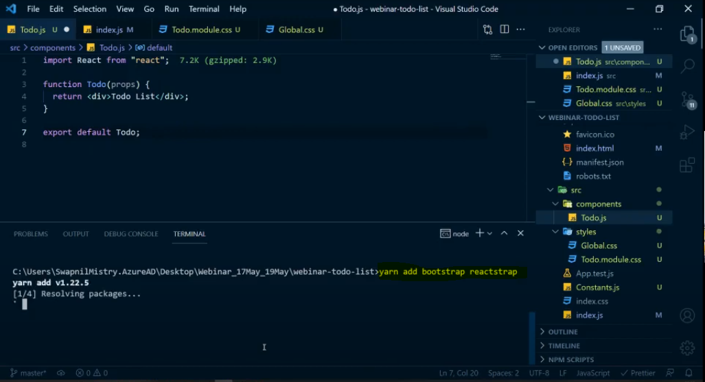

Slide 20
If you don’t want to install bootstrap then we can use CDN(Content Delivery Network or Content Distribution Network.)
https://reactstrap.github.io/
Simply import this file in index.html inside <script> tag
https://cdnjs.cloudflare.com/ajax/libs/reactstrap/4.8.0/reactstrap.min.js

Slide 21
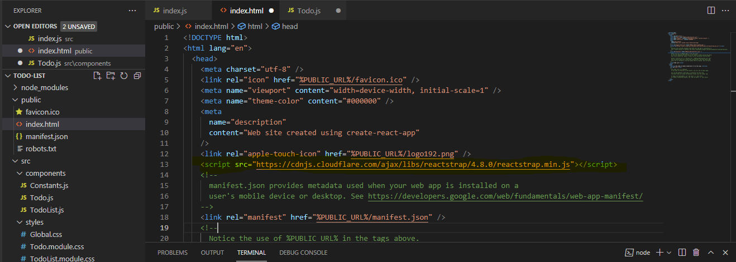
If you don’t want to install bootstrap then we can use CDN inside index.html, put inside <script> tag

Slide 22
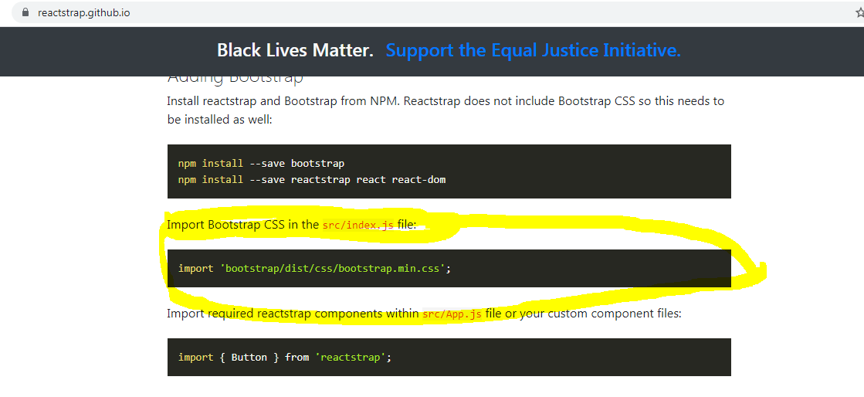

Slide 23
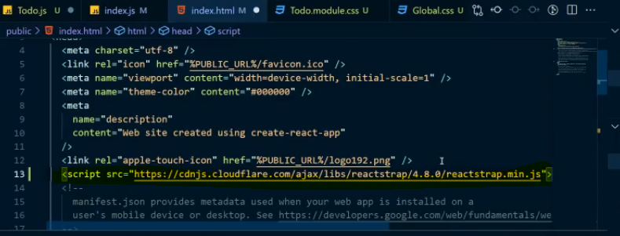

Slide 24
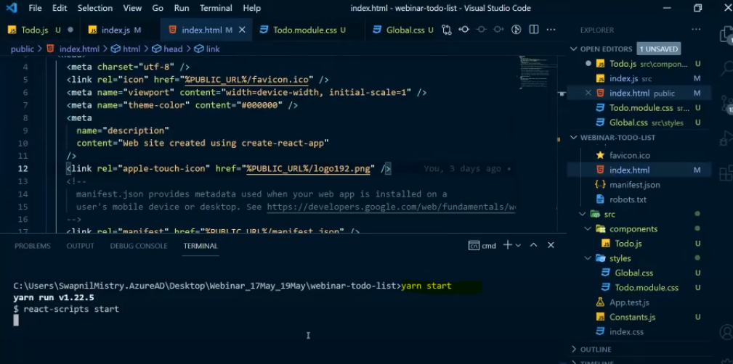
We will start development server.

Slide 25
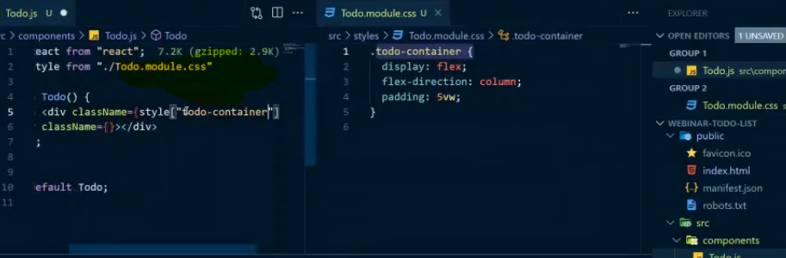
Now inside this Todo function of todo.js we will have div as parent tag, now inside this Todo we need one thing a single input bar and a search bar, now will create one div over here whose class name will be something,
Here 1st div is a container so it will also have class name,
Here we are importing css file in this way:-
import style from "../styles/Todo.module.css";
Classname will be written in different format.

Slide 26
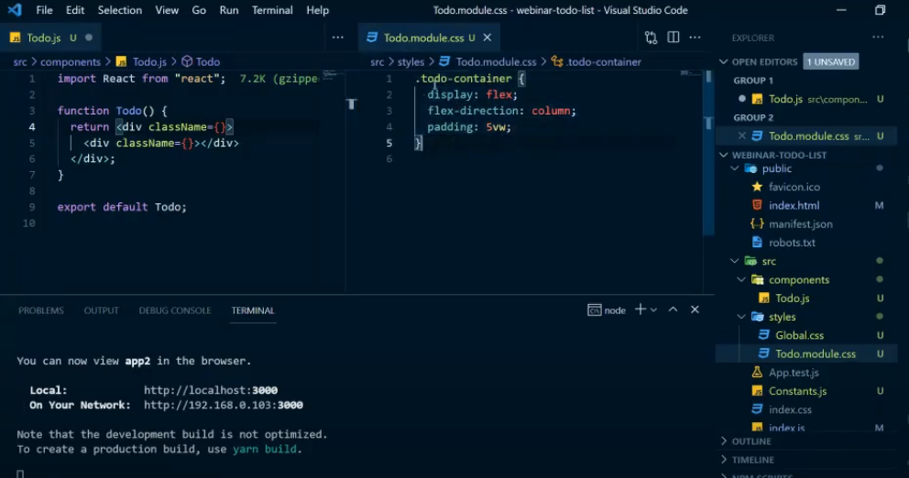
To do list will be displayed in column and display in flex.

Slide 27
Should you use CSS modules in React?
CSS Modules is a great for making CSS locally scoped and for preventing naming clashes in medium to large projects. I hope you were able to gain a better understanding of how CSS Modules work, their benefits and how you can implement them into your React application.
.module.css is where respective style is applied to respective component,
What if i want to override the existing css of other component ?
For that we have global.css.
For that purpose we need to import global.css in index.s file. So that whatever global styles are present inside can be overridden,

Slide 28
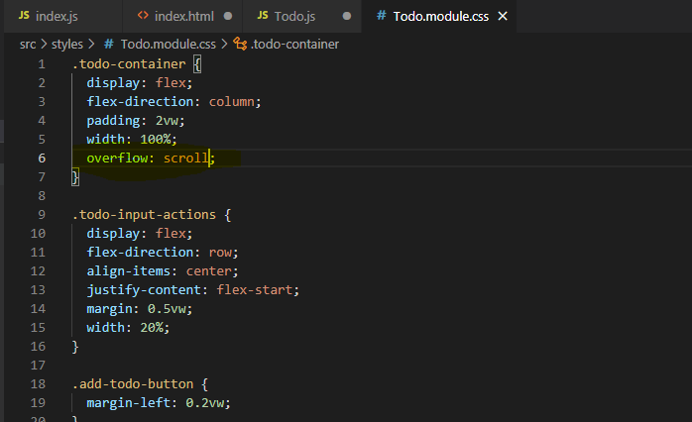
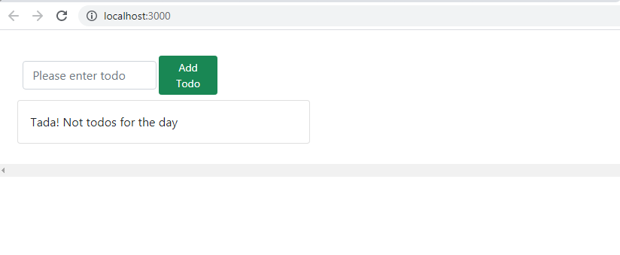
To avoid scroll bar use overflow:hidden

Slide 29
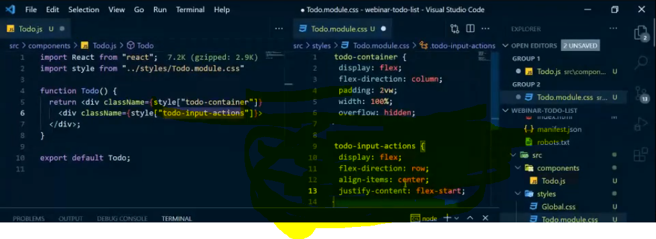
I want to see button and search bar side by side so flex-direction will be : row

Slide 30
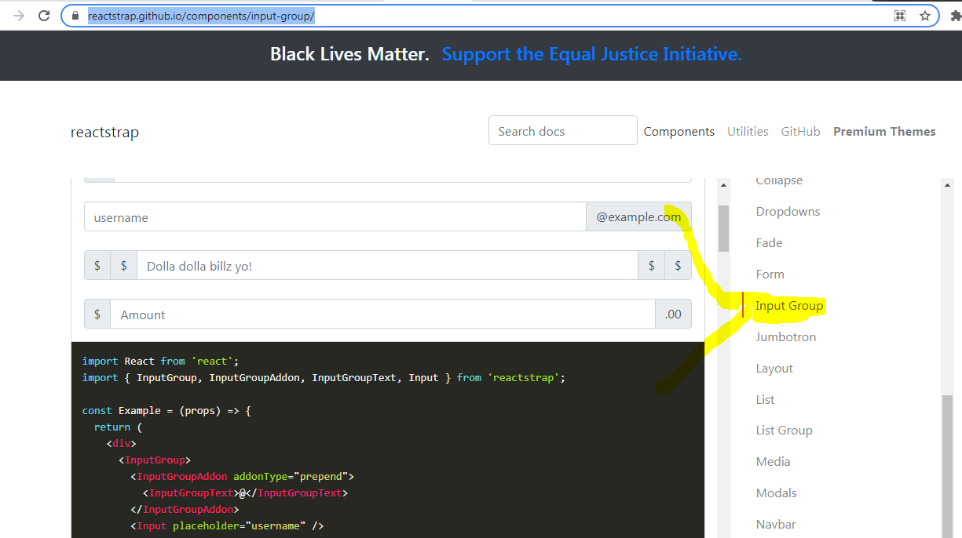
https://reactstrap.github.io/components/input-group/

Slide 31
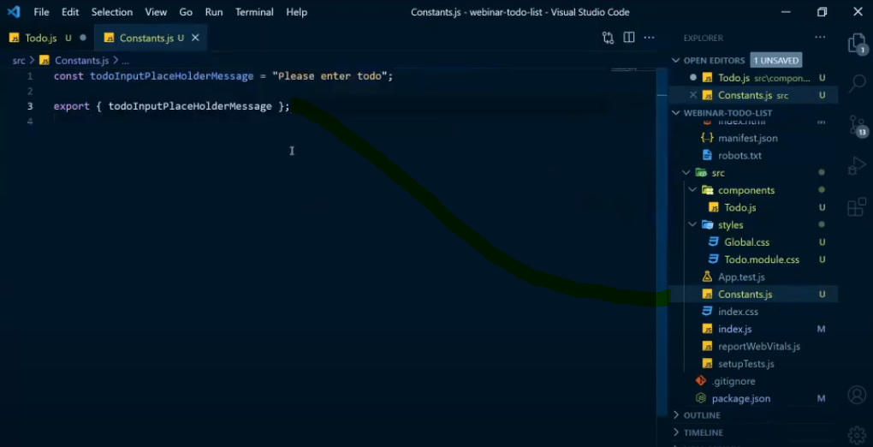
For std. Template message, create message inside constants.js and import it in Todo.js
import { todoInputPlaceHolderMessage, addTodoButtonText } from "../Constants";

Slide 32
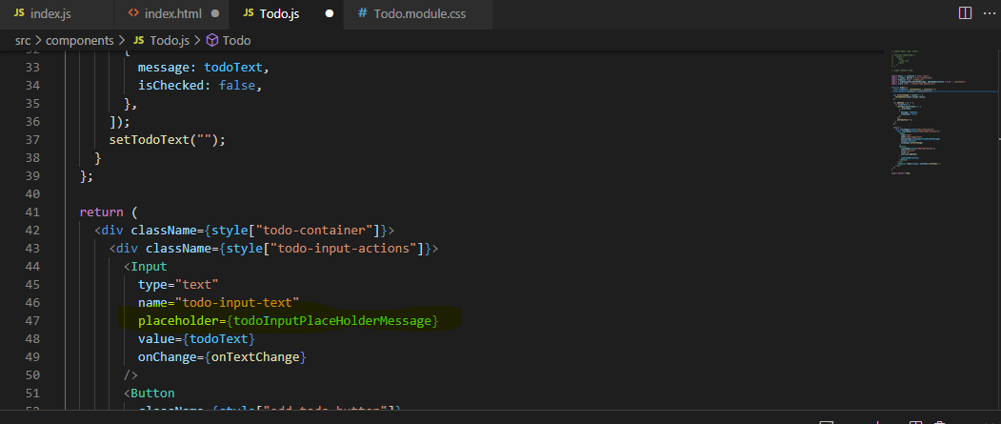
Same thing we will write inside placeholder.

Slide 33
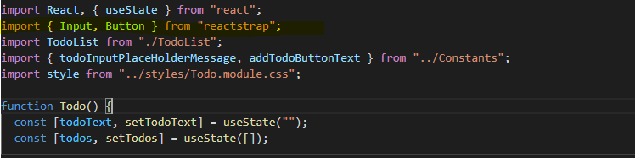
import { Input, Button } from "reactstrap";
Before execution we need to import it in reactstrap
In the same way we have added button and imported it.

Slide 34
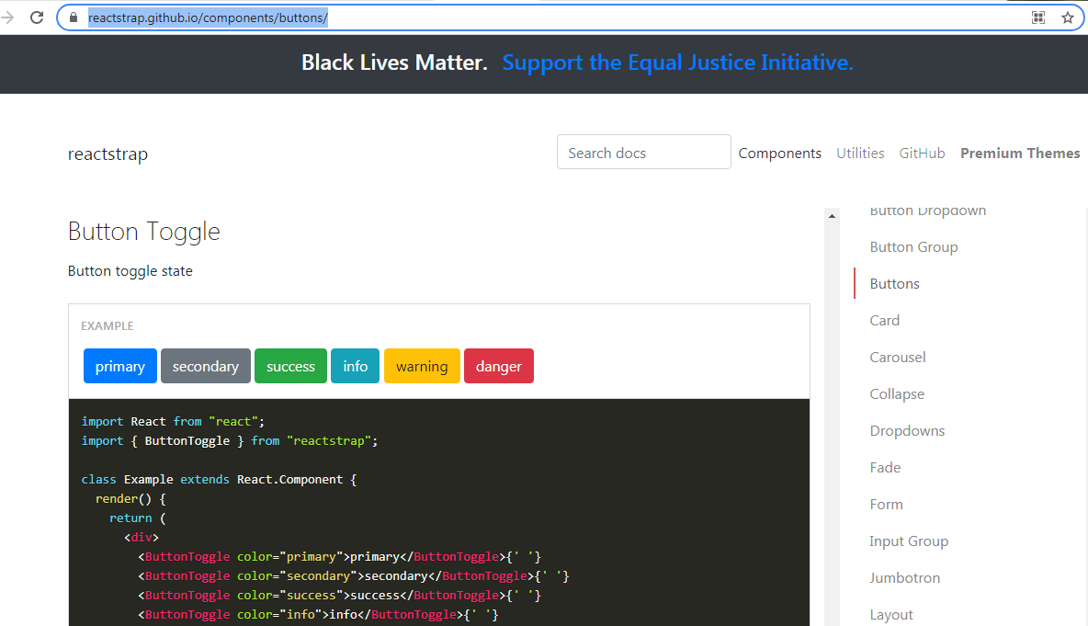
https://reactstrap.github.io/components/buttons/
To give different color to buttons

Slide 35
Now we will create one more file TodoList.js which will be responsible for displaying all list of items/Todos.

Slide 36
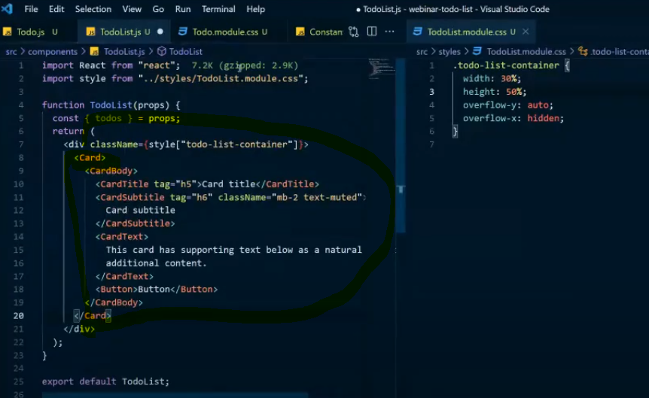
https://reactstrap.github.io/components/card/

Slide 37
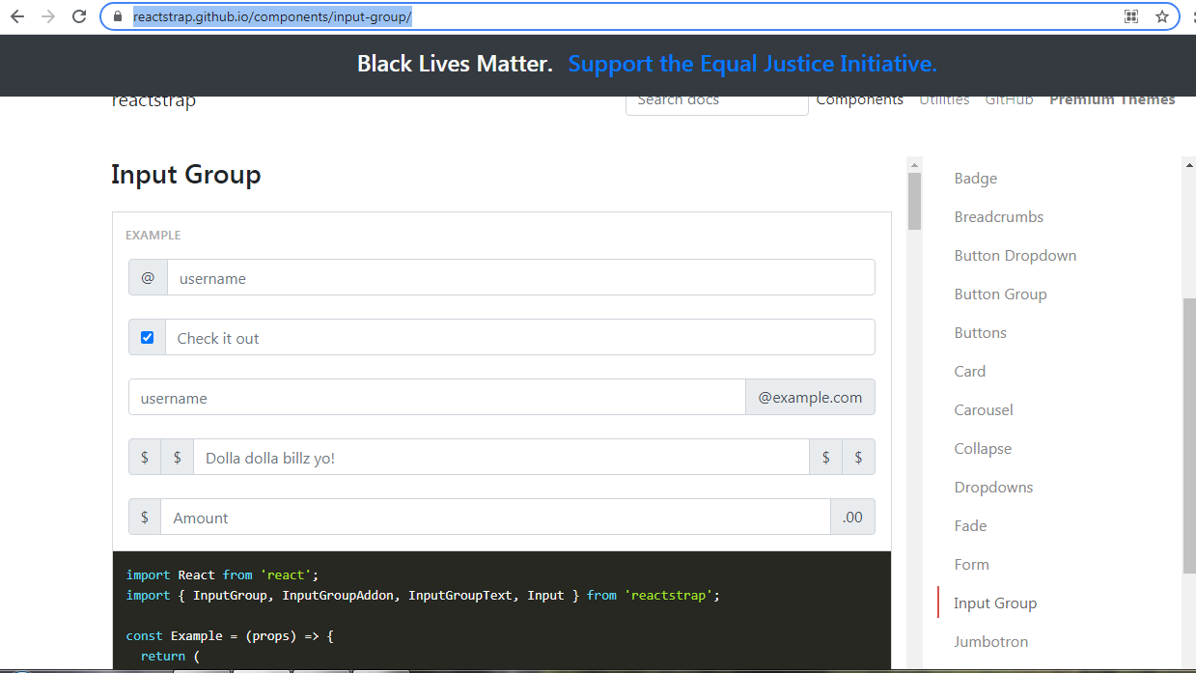
https://reactstrap.github.io/components/input-group/

Slide 38
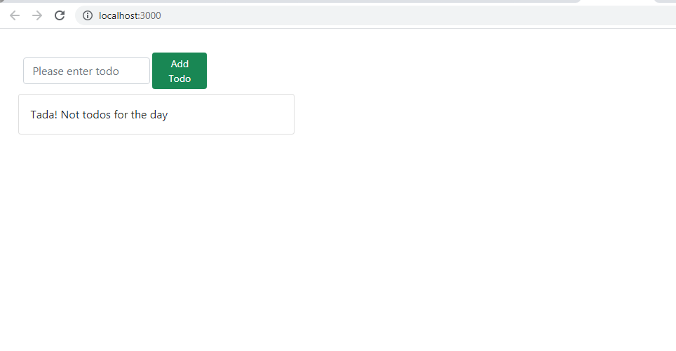

Slide 39
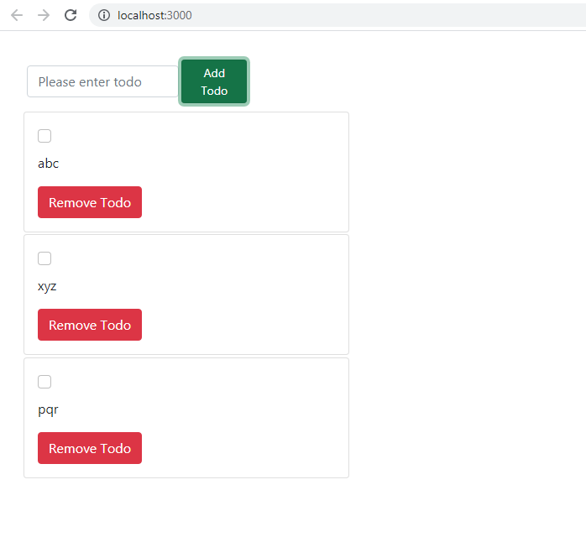

Slide 40
https://www.youtube.com/watch?v=5vFm9MFPNOo

Slide 41
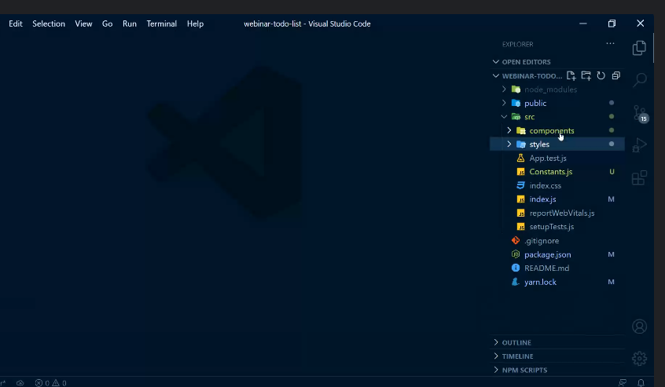

Slide 42
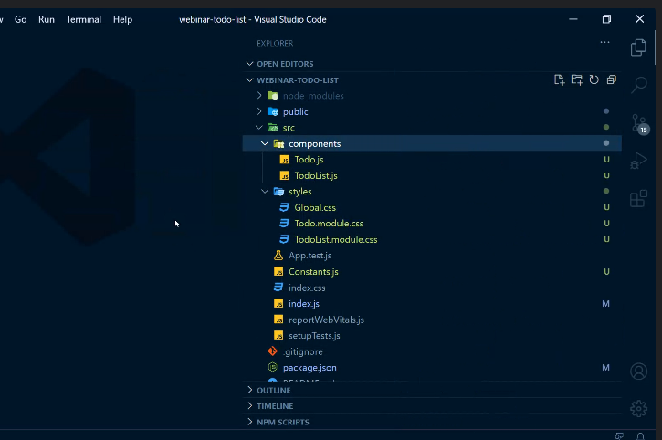

Slide 43
index.js
import React from "react";
import ReactDOM from "react-dom";
import "./index.css";
import "./styles/Global.css";
import "bootstrap/dist/css/bootstrap.min.css";
import Todo from "./components/Todo";
import reportWebVitals from "./reportWebVitals";
ReactDOM.render(
<React.StrictMode>
<Todo />
</React.StrictMode>,
document.getElementById("root")
);
// If you want to start measuring performance in your app, pass a function
// to log results (for example: reportWebVitals(console.log))
// or send to an analytics endpoint. Learn more: https://bit.ly/CRA-vitals
reportWebVitals();

Slide 44
Todo.js
import React, { useState } from "react";
import { Input, Button } from "reactstrap";
import TodoList from "./TodoList";
import { todoInputPlaceHolderMessage, addTodoButtonText } from "../Constants";
import style from "../styles/Todo.module.css";
function Todo() {
const [todoText, setTodoText] = useState("");
const [todos, setTodos] = useState([]);
let onTextChange = (event) => {
setTodoText(event.target.value);
};
let addTodo = () => {
setTodos((prevTodos) => [
...prevTodos,
{
message: todoText,
isChecked: false,
},
]);
setTodoText("");
};
return (
<div className={style["todo-container"]}>
<div className={style["todo-input-actions"]}>
<Input
type="text"
name="todo-input-text"
placeholder={todoInputPlaceHolderMessage}
value={todoText}
onChange={onTextChange}
/>
<Button
className={style["add-todo-button"]}
color="success"
size="sm"
onClick={addTodo}
>
{addTodoButtonText}
</Button>
</div>
<TodoList todos={todos} setTodos={setTodos} />
</div>
);
}
export default Todo;

Slide 45
TodoList.js
import React from "react";
import { Card, CardBody, CardTitle, CardText, Button, Input } from "reactstrap";
import { removeTodoButtonText, noTodosFound } from "../Constants";
import style from "../styles/TodoList.module.css";
function TodoList(props) {
const { todos, setTodos } = props;
let toogleCheckbox = (index) => {
let tempTodos = JSON.parse(JSON.stringify(todos));
tempTodos[index].isChecked = !tempTodos[index].isChecked;
setTodos(tempTodos);
};
let deleteTodo = (index) => {
let tempTodos = JSON.parse(JSON.stringify(todos));
tempTodos.splice(index, 1);
setTodos(tempTodos);
};
return (
<div className={style["todo-list-container"]}>
{todos.length ? (
todos.map((todo, index) => (
<Card key={index} className={style["todo-card"]}>
<CardBody>
<CardTitle>
<Input
type="checkbox"
checked={todo.isChecked}
onClick={() => toogleCheckbox(index)}
/>
</CardTitle>
<CardText>{todo.message}</CardText>
<Button color="danger" onClick={() => deleteTodo(index)}>
{removeTodoButtonText}
</Button>
</CardBody>
</Card>
))
) : (
<Card>
<CardBody>
<CardText>{noTodosFound}</CardText>
</CardBody>
</Card>
)}
</div>
);
}
export default TodoList;

Slide 46
Constants.js
const todoInputPlaceHolderMessage = "Please enter todo";
const addTodoButtonText = "Add Todo";
const removeTodoButtonText = "Remove Todo";
const noTodosFound = "Tada! Not todos for the day";
export {
todoInputPlaceHolderMessage,
addTodoButtonText,
removeTodoButtonText,
noTodosFound,
};

Slide 47
Todo.module.css
.todo-container {
display: flex;
flex-direction: column;
padding: 2vw;
width: 100%;
overflow: hidden;
}
.todo-input-actions {
display: flex;
flex-direction: row;
align-items: center;
justify-content: flex-start;
margin: 0.5vw;
width: 20%;
}
.add-todo-button {
margin-left: 0.2vw;
}

Slide 48
TodoList.module.css
.todo-list-container {
width: 30%;
height: 50%;
overflow-y: auto;
overflow-x: hidden;
}
.todo-card {
margin: 0.2vw;
}

Slide 49
Global.css
.form-control {
width: 70% !important;
}

Slide 50
RouterDemo.js
Router
import React from "react";
import { BrowserRouter as Router, Switch, Route, Link } from "react-router-dom";
import Home from "./Home";
import About from "./About";
import User from "./User";
import PageNotFound from "./PageNotFound";
function RouterDemo() {
return (
<Router>
<div>
<nav>
<ul>
<li>
<Link to="/">Home</Link>
</li>
<li>
<Link to="/about">About</Link>
</li>
<li>
<Link to="/user">User</Link>
</li>
</ul>
</nav>
<Switch>
<Route path="/" exact component={Home} />
<Route path="/about" exact component={About} />
<Route path="/user" exact component={User} />
<Route component={PageNotFound} />
</Switch>
</div>
</Router>
);
}
export default RouterDemo;

Slide 51
About.js
import React from "react";
function About() {
return <div>Welcome to About Page!</div>;
}
export default About;

Slide 52
PageNotFound.js
import React from "react";
import { Link } from "react-router-dom";
function PageNotFound() {
return (
<div>
We cannot find a page you were looking for.
<Link to="/">Try the Homepage.</Link>
</div>
);
}
export default PageNotFound;

Slide 54
Create account in Gitlab using gmail
https://gitlab.com/users/sign_up
https://github.com/signup?source=login
https://codesandbox.io/
https://git-scm.com/
https://gitlab.com/swapnilmistry/react-webinar-vcet.git

Slide 55
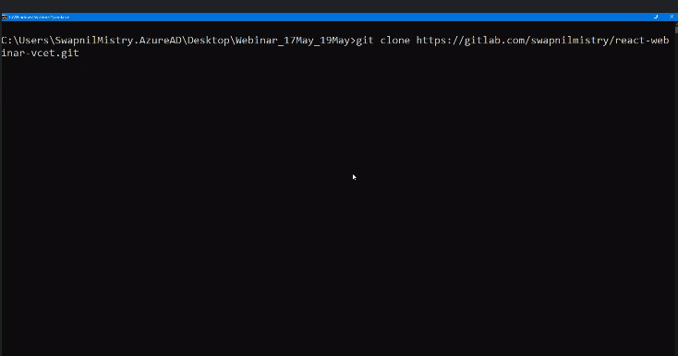

Slide 56
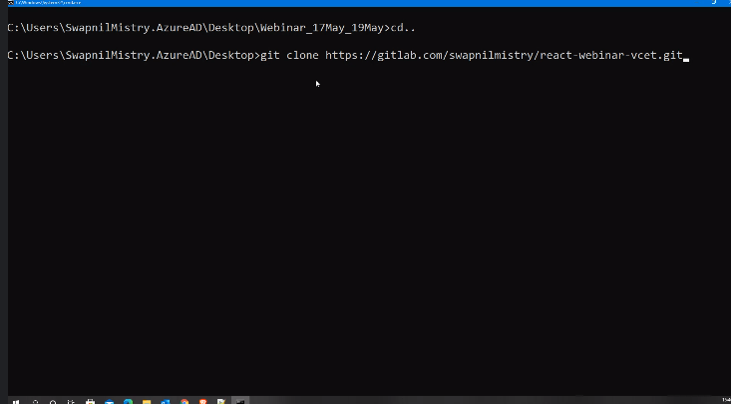

Slide 57
git clone https://gitlab.com/swapnilmistry/react-webinar-vcet.git

